Slide 1
Introduction to Deep Learning for Computer Vision
Siva
Slides borrowed from Prof. Yapeng Tian

Slide 2
Image Filtering
Modify the pixels in an image based on some function of a local neighborhood of each pixel
10
5
3
Some function
4
5
1
7
1
1
7
Local image data
Modified image data
Slide credit: N. Snavely

Slide 3
Linear filtering
A simple filtering: linear filtering (cross-correlation/convolution)
Replace each pixel by a linear combination (a weighted sum) of its neighbors
The prescription for the linear combination is called the “kernel” (or “mask”, “filter”)
10
5
3
0
0
0
4
6
1
0
0.5
0
8
1
1
8
0
1
0.5
Local image data
kernel
Modified image data
Slide credit: N. Snavely

Slide 4



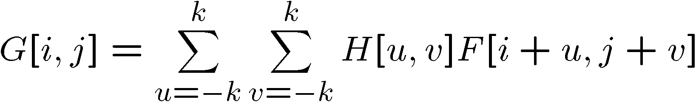

Cross-correlation
Let be the image, be the kernel (of size 2k+1 x 2k+1), and be the output image
This is called a cross-correlation operation:
Can think of as a “dot product” between local neighborhood and kernel for each pixel
Slide credit: N. Snavely

Slide 5
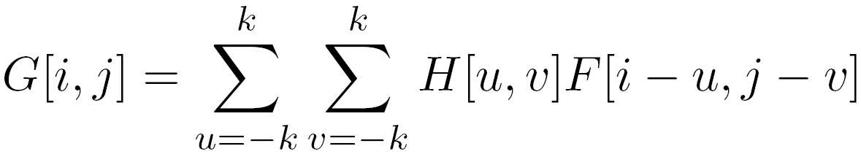

Convolution
Same as cross-correlation, except that the kernel is “flipped” (horizontally and vertically)
Convolution is commutative and associative
This is called a convolution operation:
Slide credit: N. Snavely

Slide 6



Convolution
Kernel
Flipped
Kernel
Adapted from F. Durand

Slide 7

Mean filtering
0 | 0 | 0 | 0 | 0 | 0 | 0 | 0 | 0 | 0
0 | 0 | 0 | 0 | 0 | 0 | 0 | 0 | 0 | 0
0 | 0 | 0 | 90 | 90 | 90 | 90 | 90 | 0 | 0
0 | 0 | 0 | 90 | 90 | 90 | 90 | 90 | 0 | 0
0 | 0 | 0 | 90 | 90 | 90 | 90 | 90 | 0 | 0
0 | 0 | 0 | 90 | 0 | 90 | 90 | 90 | 0 | 0
0 | 0 | 0 | 90 | 90 | 90 | 90 | 90 | 0 | 0
0 | 0 | 0 | 0 | 0 | 0 | 0 | 0 | 0 | 0
0 | 0 | 90 | 0 | 0 | 0 | 0 | 0 | 0 | 0
0 | 0 | 0 | 0 | 0 | 0 | 0 | 0 | 0 | 0
 | 0 | 10 | 20 | 30 | 30 | 30 | 20 | 10
 | 0 | 20 | 40 | 60 | 60 | 60 | 40 | 20
 | 0 | 30 | 60 | 90 | 90 | 90 | 60 | 30
 | 0 | 30 | 50 | 80 | 80 | 90 | 60 | 30
 | 0 | 30 | 50 | 80 | 80 | 90 | 60 | 30
 | 0 | 20 | 30 | 50 | 50 | 60 | 40 | 20
 | 10 | 20 | 30 | 30 | 30 | 30 | 20 | 10
 | 10 | 10 | 10 | 0 | 0 | 0 | 0 | 0
*
=
1 | 1 | 1
1 | 1 | 1
1 | 1 | 1
Slide credit: N. Snavely

Slide 8
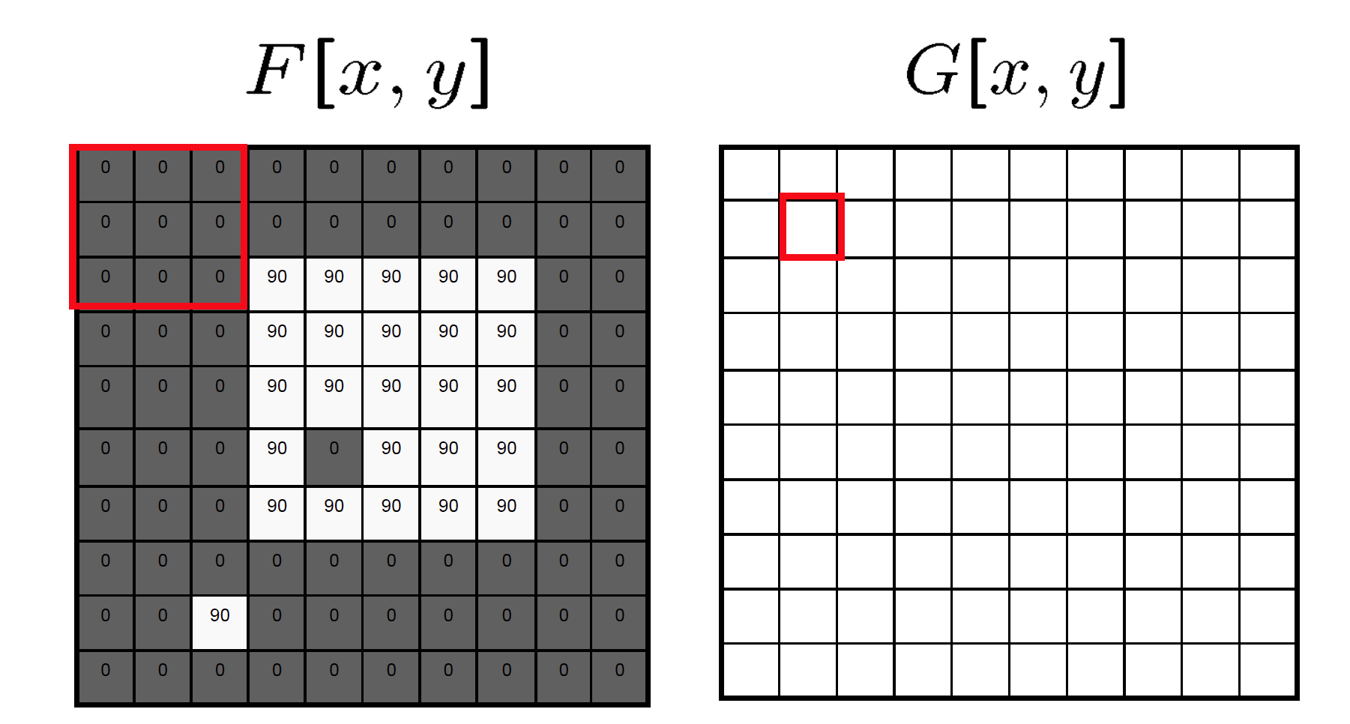
Mean filtering/Moving average
Slide credit: N. Snavely

Slide 9
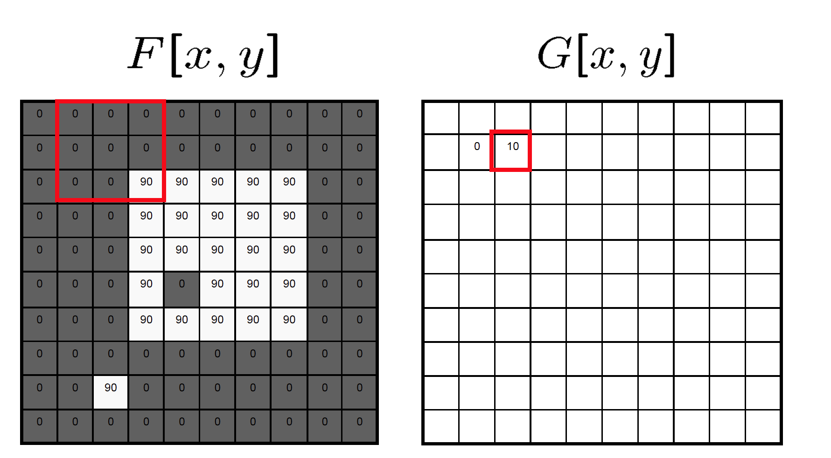
Mean filtering/Moving average
Slide credit: N. Snavely

Slide 10

Mean filtering/Moving average
Slide credit: N. Snavely

Slide 11
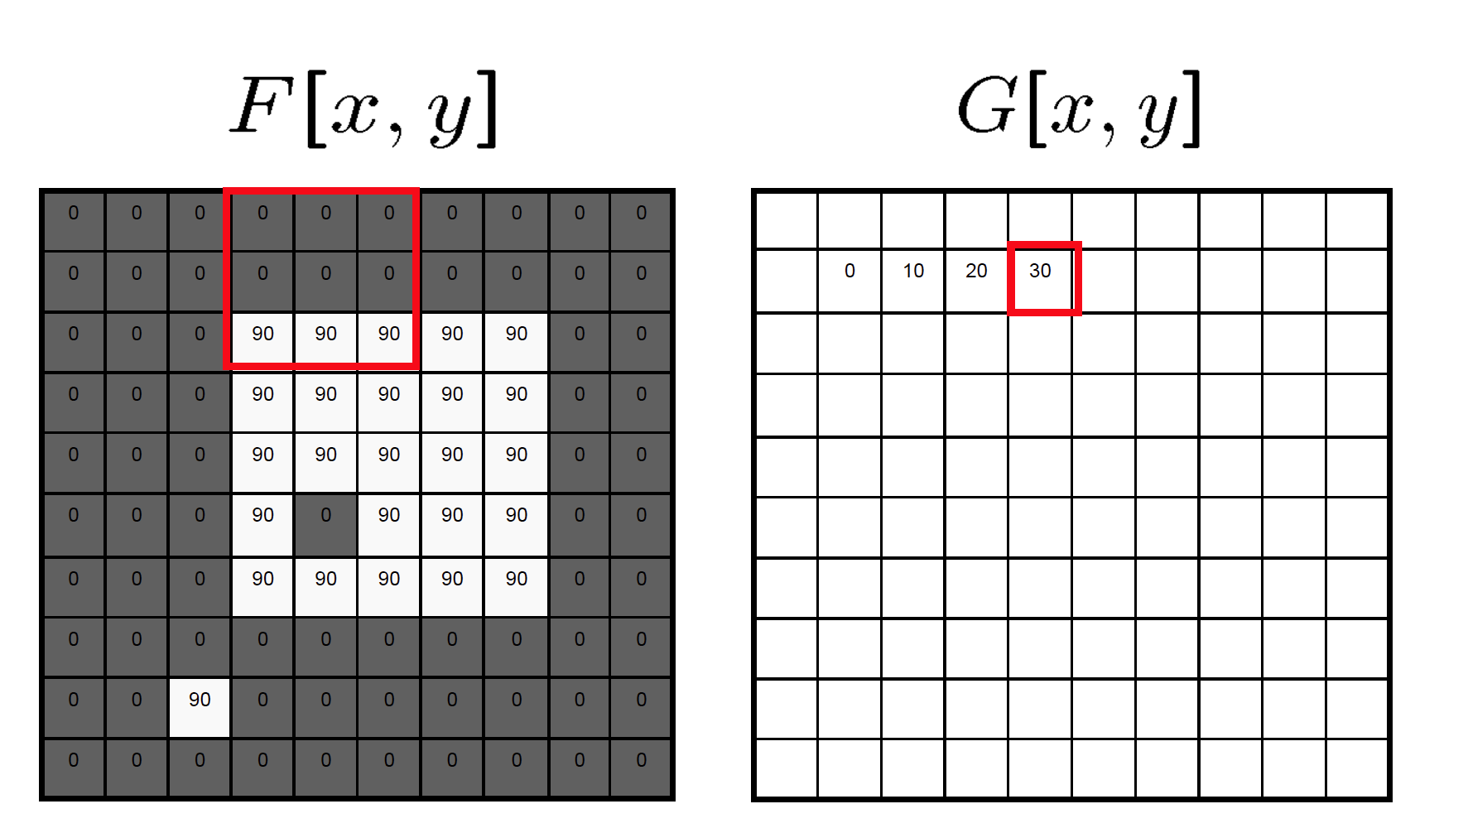
Mean filtering/Moving average
Slide credit: N. Snavely

Slide 12
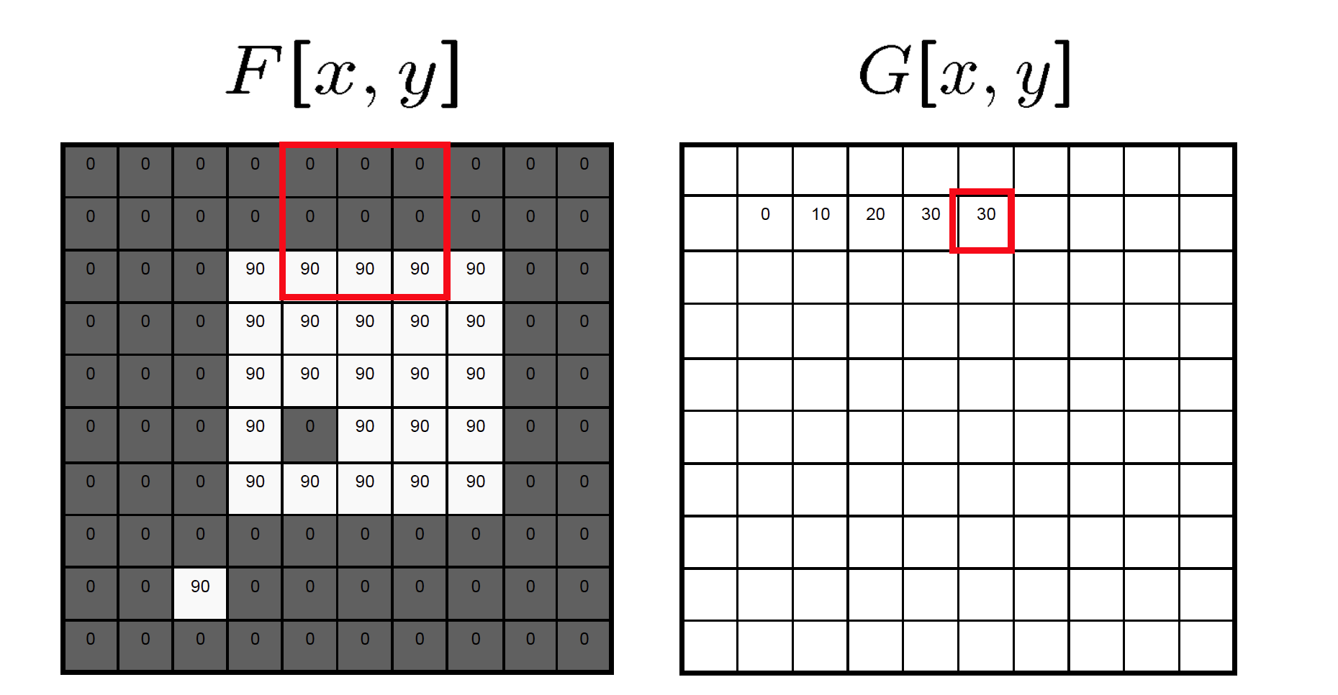
Mean filtering/Moving average
Slide credit: N. Snavely

Slide 13
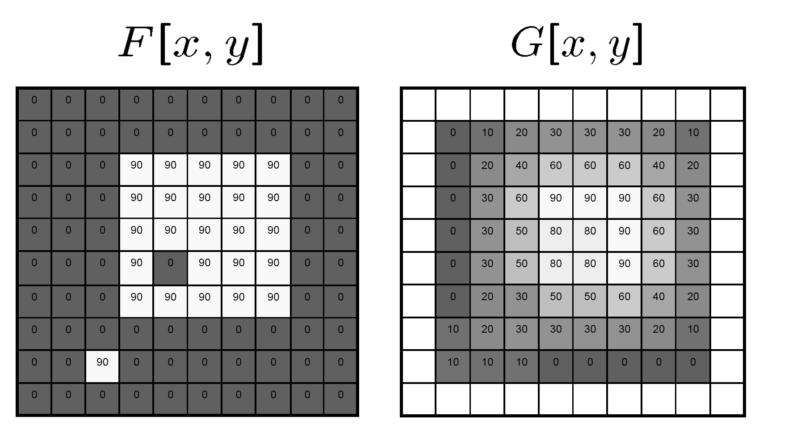
Mean filtering/Moving average
Slide credit: N. Snavely

Slide 14
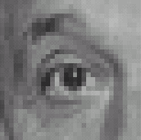
Linear filters: examples
*
0
0
0
0
1
0
0
0
0
Original
Source: D. Lowe

Slide 15
Linear filters: examples
*
0
0
0
=
0
1
0
0
0
0
Original
Identical image
Source: D. Lowe

Slide 16
Linear filters: examples
*
0
0
0
1
0
0
0
0
0
Original
Source: D. Lowe

Slide 17
Linear filters: examples
*
0
0
0
=
1
0
0
0
0
0
Original
Shifted left by 1 pixel
Source: D. Lowe

Slide 18
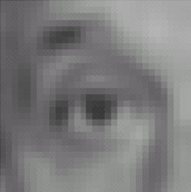

Linear filters: examples
*
1
1
1
=
1
1
1
1
1
1
Original
Blur (with a mean/box filter)
Source: D. Lowe

Slide 19
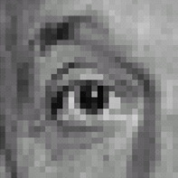



Linear filters: examples
*
0
0
0
-
1
1
1
=
0
2
0
1
1
1
0
0
0
1
1
1
Sharpening filter
Original
Source: D. Lowe

Slide 20
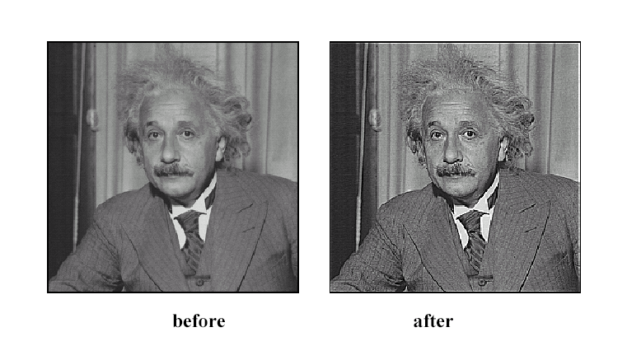
Sharpening
Source: D. Lowe

Slide 21
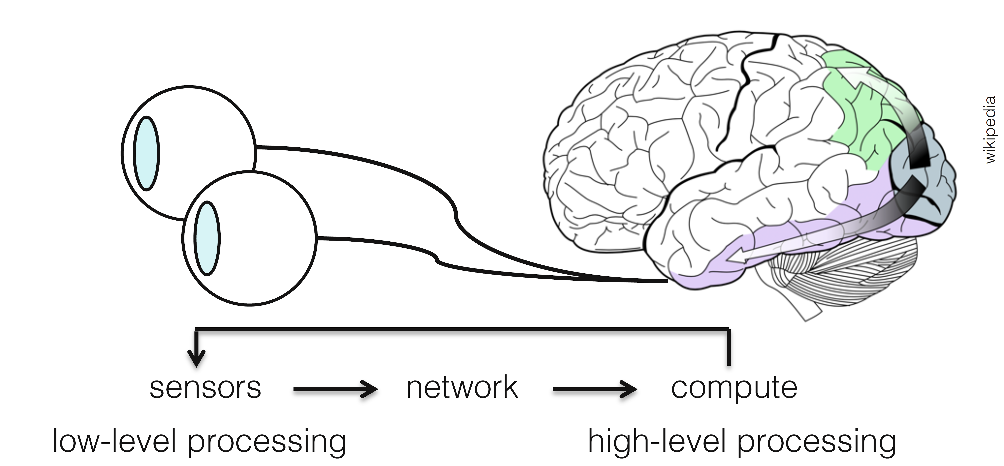

Visual Perception vs. Computational Perception
High-level information
Depth
Motion
Object classes
Object poses
Etc.
Neural Network
Image
Notes:
Similar to human visual perception, our deep neural networls can perform compulational perception to understand high-level visual inforation in visual images.

Slide 22
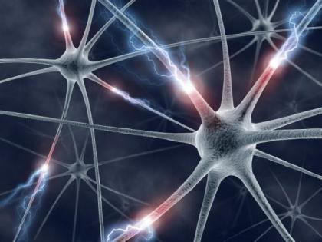



Mathematic Models
Try to model the human brain with computational models, e.g., neural networks
Image
Object class
Notes:
More formally spearking, we try to model the human brain with a nonlinear function f(x). Neural network can be used to learn the function using massive training images.

Slide 23

Mathematic Models
What is the form of the function ?
No idea!
Concatenate simple functions (neurons)
Dog
Notes:
One question is what the form of the function is. The answer is we do not know. It is too complicated to write the function.
Here, we use cancatenate simple functions to approximate the f.

Slide 24



Neural Network: Concatenation of functions
Linear score function:
2-layer Neural Network
Non-linearity
x
h
W1
W2
s
3072
100
10
Notes:
Here is a linear score function f = Wx.
We can concatenate it to learn a 2-layer neural network. A nonlinear function is used at the end of the first layer.

Slide 25
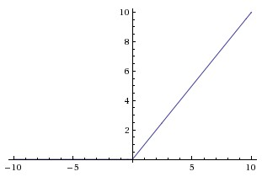
Activation Functions
2-layer Neural Network
rectified linear unit (ReLU) max(0,x)
Introduce non-linearity to the network
Notes:
There is a nonlinear function inside the network. The nonlinear function is called as activation function. This max(0, x) is usually named as ReLU function.
When, x is smaller than 0, the function output is 0, when it is larger than 0, it is equal to x. It introduces nonlinearity into to the network.

Slide 26
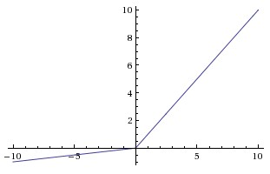
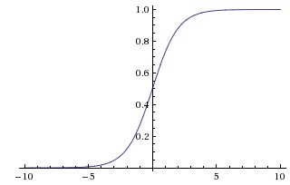


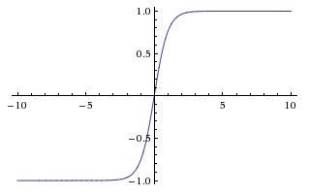


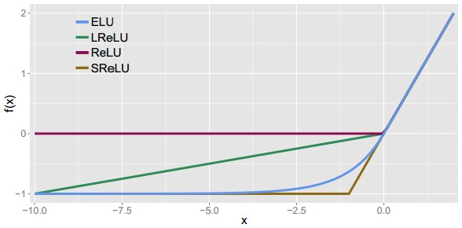

Activation Functions
Leaky ReLU
max(0.1x, x)
Sigmoid
Maxout
tanh tanh(x)
ELU Exponential Linear Unit
Hyperbolic tangent
ReLU max(0,x)
Notes:
It suffers from saturation problem. A neuron is considered as saturated if it reaches its maximum or minimum value so that its derivative is equal to 0. In that case, there is no update in weights.
As its derivative is not 0 for the positive values of the neuron (f’(x)=1 for x ≥ 0), ReLu does not saturate and no dead neurons are reported. Saturation and vanishing gradient only occur for negative values that, given to ReLu, are turned into 0.
In an attempt to solve the dying ReLu at negative values, Leaky ReLu introduces a small slope. Having the negative values scaled by α enables their corresponding neurons to “stay alive”.

Slide 27


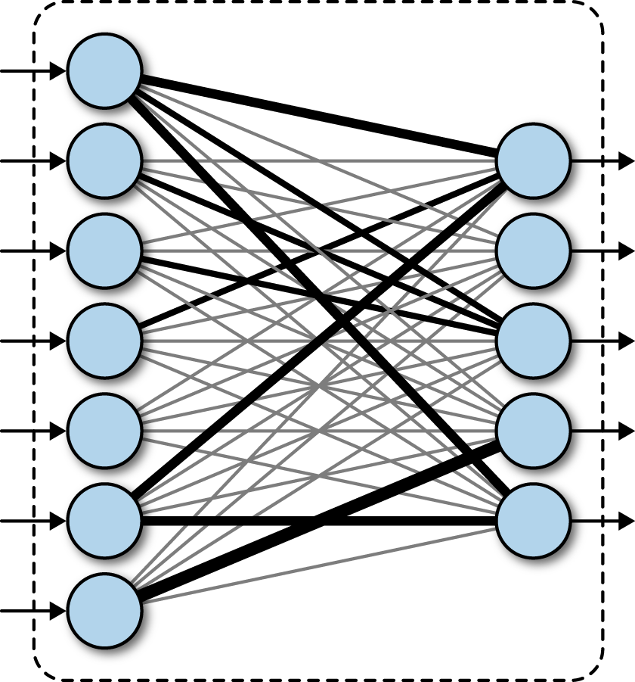


Fully Connected Layer
Notes:
For the linear layer, given input x, the layer outputs y in terms of the learnt weights W. The fully connected layer defines a linear mapping between x and y.
Here we have n neurons in the input layer and m neurons in output and there mxn parameters in the FC layer.

Slide 28
Fully Connected Layer
What is the drawback of only using fully connected layers?
Consider an image with 640 x 480
x is with dimension 307,200
The weight matrix of the fully connect layer is too large
Notes:
The FC layer is very simple. Whether there are any drawbacks for the FC layers?
Consider an image with 640 x 480 as the input, what is the dimension of x. It is 307,200. Then the weight matrix of the FC layer is very large.

Slide 29
Convolutional Layers
Consist of convolutional filters
Share weights among different image locations
Notes:
There are actually more efficient and effective neural layers: convolutional layers.
It consists convolutional filters and the filters share weights among different locations.
Here the filters in convolutional neunural network are similar to image filters we introduced before. But differently, we will learn the weights rather than using fixed weights.

Slide 30

Convolutional Layers
Consist of convolutional filters
Share weights among different image locations
Gaussian Filter
Learn the weights!
Notes:
There are actually more efficient and effective neural layers: convolutional layers.
It consists convolutional filters and the filters share weights among different locations.
Here the filters in convolutional neunural network are similar to image filters we introduced before. But differently, we will learn the weights rather than using fixed weights.

Slide 31
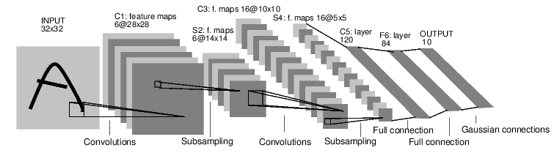
Convolutional Neural Networks
[LeNet-5, LeCun 1980]
Notes:
This is the LeNet-5, which is a father model for current modern deep networks. It was proposed in 1980,
LeNet-5 CNN architecture is made up of 7 layers. The layer composition consists of 3 convolutional layers, 2 subsampling layers and 2 fully connected layers. For the next, we will dive into details about the network architecture.

Slide 32
Convolutional Neural Networks
…
Input image
Output vector
Fully connected layer
Convolutional
layer
ReLU
layer
Pooling
layer
(translation invariant)
Notes:
Given an input image, we will stack multiple ocnvolution blocks to obtain feature maps and flatten them to a feature vector. We further use FC layers to process the feature to make precition.

Slide 33
Convolutional Layer
32x32x3 image
32
height
32
width
3
depth
Notes:
First, let’s say we have a 32 by 32 RGB(3 channel) image.

Slide 34
Convolutional Layer
32x32x3 image
5x5x3 filter
32
Convolve the filter with the image
i.e. “slide over the image spatially, computing dot products”
32
3
Notes:
Convolution layer has a set of “convolution filters” as its parameters.

Slide 35


Convolutional Layer
32x32x3 image
5x5x3 filter
32
1 number:
the result of taking a dot product between the filter and a small 5x5x3 chunk of the image
(i.e. 5*5*3 = 75-dimensional dot product + bias)
32
3
Notes:
The convolution operation can also be understood as taking the inner product of the input with the “convolution filter” at every location of the input. For example, at the location where the blue filter is currently at, the output is going to be a single number taking the result from the dot product between the filter and the portion of size 5*5*3.

Slide 36
Convolutional Layer
activation map
32x32x3 image
5x5x3 filter
32
28
convolve (slide) over all spatial locations
32
28
3
1
Notes:
The output activation map corresponding to one convolution filter will be the result such dot products at all spatial location of the input.

Slide 37
A closer look at spatial dimensions:
7
7x7 input (spatially)
assume 3x3 filter, with stride 1
7
Notes:
For this example, we’ll assume we have a 7 by 7 single channel input image and a 3 by 3 single channel convolutional filter with the convolution stride of 1. Watch how the spatial extend is changing in a sliding windows fashion at the sliding resolution of 1.

Slide 38
A closer look at spatial dimensions:
7
7x7 input (spatially)
assume 3x3 filter
7

Slide 39
A closer look at spatial dimensions:
7
7x7 input (spatially)
assume 3x3 filter
7

Slide 40
A closer look at spatial dimensions:
7
7x7 input (spatially)
assume 3x3 filter
7

Slide 41
A closer look at spatial dimensions:
7
7x7 input (spatially)
assume 3x3 filter
7

Slide 42
A closer look at spatial dimensions:
7
7x7 input (spatially)
assume 3x3 filter
7

Slide 43
A closer look at spatial dimensions:
7
7x7 input (spatially)
assume 3x3 filter
7

Slide 44
A closer look at spatial dimensions:
7
7x7 input (spatially)
assume 3x3 filter
7

Slide 45
A closer look at spatial dimensions:
7
7x7 input (spatially)
assume 3x3 filter
7

Slide 46
A closer look at spatial dimensions:
7
7x7 input (spatially)
assume 3x3 filter
=> 5x5 output
7
Notes:
We obtain a 5x5 output using a 3x3 filter for the 7x7 input.

Slide 47
A closer look at spatial dimensions:
7
7x7 input (spatially)
assume 3x3 filter
applied with stride 2
7
Notes:
Now, if we increase the stride, we get smaller output activation map because we evaluate the filter at less locations.

Slide 48
A closer look at spatial dimensions:
7
7x7 input (spatially)
assume 3x3 filter
applied with stride 2
7
Notes:
More animation

Slide 49
A closer look at spatial dimensions:
7
7x7 input (spatially)
assume 3x3 filter
applied with stride 2
=> 3x3 output!
7
Output size:
(N - F) / stride + 1
Notes:
In fact, the output dimension is determined as (N-F)/S+ 1 where N is the input dimension, F is the filter dimension, and S is the stride.

Slide 50
A closer look at spatial dimensions:
7
7x7 input (spatially)
assume 3x3 filter
applied with stride 3?
7
Notes:
If (N-F) is not divisible by S, then we have a problem because the last stride goes out of the bound.

Slide 51
A closer look at spatial dimensions:
7
7x7 input (spatially)
assume 3x3 filter
applied with stride 3?
7
Notes:
If (N-F) is not divisible by S, then we have a problem because the last stride goes out of the bound.

Slide 52
A closer look at spatial dimensions:
7
7x7 input (spatially)
assume 3x3 filter
applied with stride 3?
7
doesn’t fit!
cannot apply 3x3 filter on 7x7 input with stride 3.
Notes:
So in this particular example with input dimension 7 and filter dimension 3, stride of 3 doesn’t work.

Slide 53
N
Output size:
(N - F) / stride + 1
e.g. N = 7, F = 3:
stride 1 => (7 - 3)/1 + 1 = 5
stride 2 => (7 - 3)/2 + 1 = 3
stride 3 => (7 - 3)/3 + 1 = 2.33
F
N
F
Notes:
If we calculate the output dimension at the stride of 1,2, and 3, we can see that we get a fraction of 2.33 as opposed to a nice integer.

Slide 54
In practice: Common to zero pad the border
0 | 0 | 0 | 0 | 0 | 0
0
0
0
0
e.g. input 7x7
3x3 filter, applied with stride 1
pad with 1 pixel border => what is the output?
(recall:)
(N - F) / stride + 1
Notes:
The common fix is to pad the four sides of the input data with zeros (thus the name zero-padding). Going back to the problem with stride of 3, we can see that we can complete exactly 3 strides by zero-padding one additional columns and rows.

Slide 55
In practice: Common to zero pad the border
0 | 0 | 0 | 0 | 0 | 0
0
0
0
0
e.g. input 7x7
3x3 filter, applied with stride 1
pad with 1 pixel border => what is the output?
7x7 output!
Notes:
In this case, we have a 7 by 7 output.

Slide 56
In practice: Common to zero pad the border
0 | 0 | 0 | 0 | 0 | 0
0
0
0
0
e.g. input 7x7
3x3 filter, applied with stride 1
pad with 1 pixel border => what is the output?
7x7 output!
in general, common to see CONV layers with stride 1, filters of size FxF, and zero-padding with (F-1)/2. (will preserve size spatially)
e.g. F = 3 => zero pad with 1
F = 5 => zero pad with 2
F = 7 => zero pad with 3
Notes:
In short, we can decide how many rows and columns or zeros to augment to the input dimension by making sure (N-F) is divisible by the stride S.

Slide 57
A closer look at spatial dimensions:
activation map
32x32x3 image
5x5x3 filter
32
28
convolve (slide) over all spatial locations
32
28
3
1
Notes:
One convolutional filter outputs one activation map.

Slide 58
Convolutional Layer
consider a second, green filter
32x32x3 image
5x5x3 filter
activation maps
32
28
convolve (slide) over all spatial locations
32
28
3
1
Notes:
Each convolution layer typically has tens to hundreds of such “convolutional filters” as the learning parameter. The full output is the concatenation of all convolution activation maps. To be concrete, if the layer has K convolutional filters, it’ll have K activation maps stacked on top of each other.

Slide 59
For example, if we had 6 5x5 filters, we’ll get 6 separate activation maps:
activation maps
32
28
Convolution Layer
32
28
3
6
We stack these up to get a “new image” of size 28x28x6!
Notes:
For example, if the convolution layer has 6 convolutional filters as the learning parameter, the final output will be 6 convolution activation maps stacked on top of each other.

Slide 60
Preview: ConvNet is a sequence of Convolution Layers, interspersed with activation functions
32
28
CONV,
ReLU
e.g. 6 5x5x3 filters
32
28
3
6
Notes:
Now, convolutional network is a neural network which has series of a set of convolutional layer followed by non-linearity layer. ReLU here is the same non-linearity we saw earlier which clips negative values to zero.

Slide 61
Preview: ConvNet is a sequence of Convolutional Layers, interspersed with activation functions
32
28
24
….
CONV,
ReLU
e.g. 6 5x5x3 filters
CONV,
ReLU
e.g. 10 5x5x6 filters
CONV,
ReLU
32
28
24
3
6
10
Notes:
We can then stack multiple CONV-RELU blocks.

Slide 62
Convolutional Neural Networks
…
Input image
Output vector
Fully connected layer
Convolutional
layer
ReLU
layer
Pooling
layer
Notes:
Next, let’s talk about the pooling layer.

Slide 63
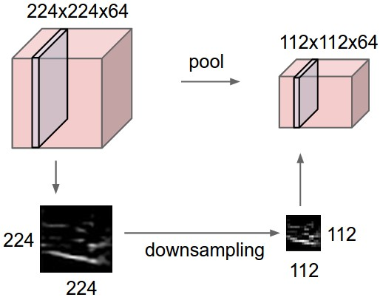
Pooling layer
makes the representations smaller and more manageable
operates over each activation map independently:
Notes:
Pooling layer can be understood as a down-sampling layer. The benefit of the pooling layer is that it makes the representations smaller in size and thus more manageable and also that it makes the representation more robust to small noise. Let’s take a look at “max-pooling” layer for example.

Slide 64
MAX POOLING
Single depth slice
1 | 1 | 2 | 4
5 | 6 | 7 | 8
3 | 2 | 1 | 0
1 | 2 | 3 | 4
x
max pool with 2x2 filters and stride 2
6 | 8
3 | 4
y
Notes:
Max pooling layer basically convolves the input representation with a special parameter-less convolution filter which outputs the maximum of its spatial extent as opposed to the conventional convolution operations which outputs the inner-product values. Using the max value makes the representation robust against small noise present in the input representations.

Slide 65
Training: back-propagate errors
…
Input image
Output
vector
GT
vector
Fully connected layer
Convolutional
layer
ReLU
layer
Pooling
layer
Notes:
Weights are parameters of conv layers and FC layers. These weights are learned from data. Supervised learning is used to train these weights. A learning procedure called back-propagation is widely used.

Slide 66
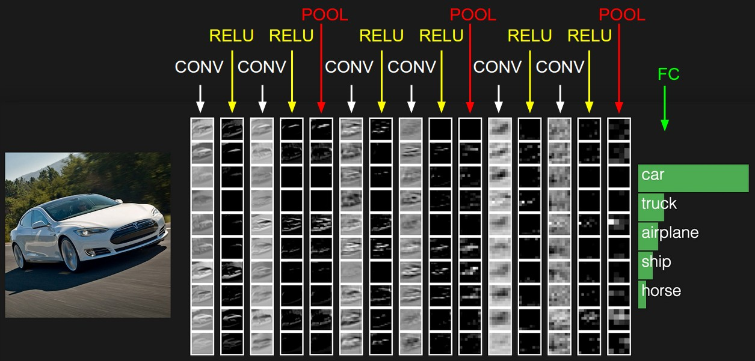
Notes:
At the end of the convolutional network, we can add a fully connected layer (matrix multiplication layer) and train a classifier which takes the convolutional activation map as input and outputs a probability vector corresponding the the classification likelihood.
The activations of an example ConvNet architecture. The initial volume stores the raw image pixels (left) and the last volume stores the class scores (right). Each volume of activations along the processing path is shown as a column. Since it's difficult to visualize 3D volumes, we lay out each volume's slices in rows. The last layer volume holds the scores for each class, but here we only visualize the sorted top 5 scores, and print the labels of each one.

Slide 67




Supervised Learning
Image
Object class
Training Data
Input
Output

Slide 68
Convolutional Neural Networks
…
Input image
Output vector
Fully connected layer
Convolutional
layer
ReLU
layer
Pooling
layer
(translation invariant)

Slide 69
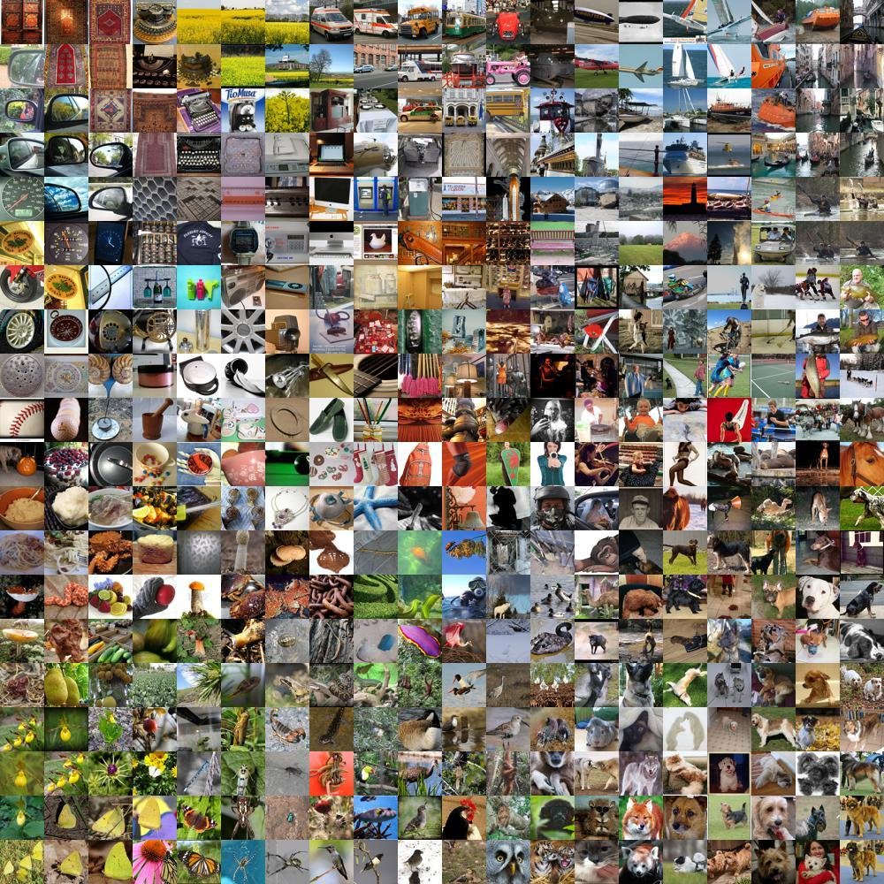
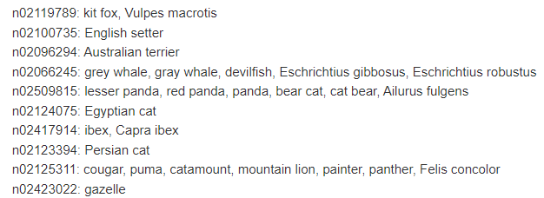
Image Classification
ImageNet dataset
Training: 1.2 million images
Testing and validation: 150,000 images
1000 categories
https://image-net.org/challenges/LSVRC/2012/index.php
Notes:
With image classification as an example. One representive image classification dataset is Imagenet. It

Slide 70


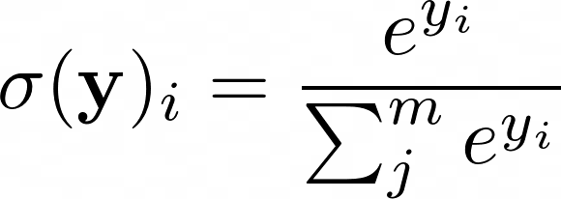

Image Classification
Let’s consider only using one FC layer
Probability distribution
Softmax function
150528
1000
Notes:
Now let us use a 1 layer fully-connected layer to address the image classification task.

Slide 71
Image Classification
Training data
One-hot vector: if an object in k-th class exists in the image, its label will be encoded as [0, 0, 0, …, 1, …, 0, 0, 0], where only k-th element in the vector is 1
Image
label
Ground truth category

Slide 72
Image Classification
1
…
0
1
m-1
The goal of training
1
Ground truth
…
…
0
1
m-1
Notes:
Sigma(y) the predicted class distribution, which has m values and sum of the m values is 1. We hope the predicted sigma(y) is close to the ground truth.

Slide 73


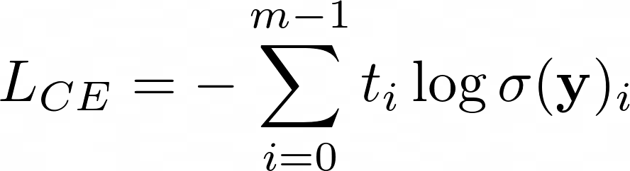
Image Classification
1
Cross entropy loss function
Cross entropy between two distributions
(measure distance between distributions)
…
0
1
m-1
1
Ground truth
…
…
0
1
m-1

Slide 74
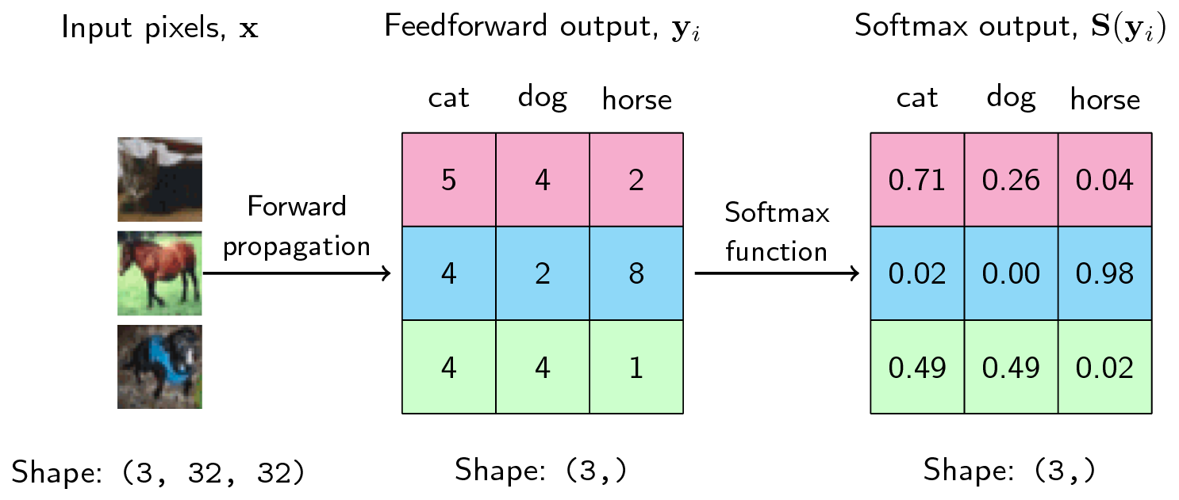

https://ljvmiranda921.github.io/notebook/2017/08/13/softmax-and-the-negative-log-likelihood/

Slide 75


Training
Cross entropy loss function
Minimize
With respect to weights W

Slide 76
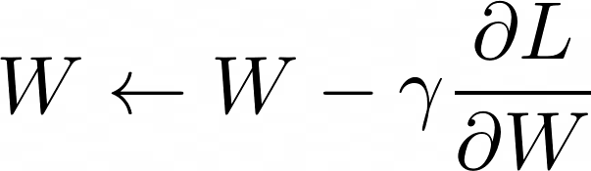
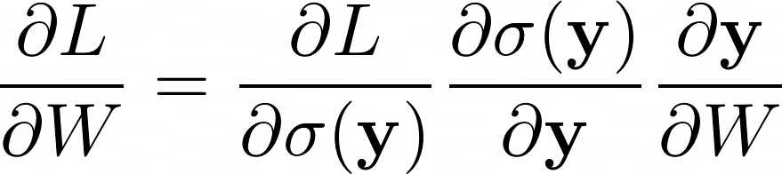
Training
Gradient descent
Chain rule
Learning rate

Slide 77
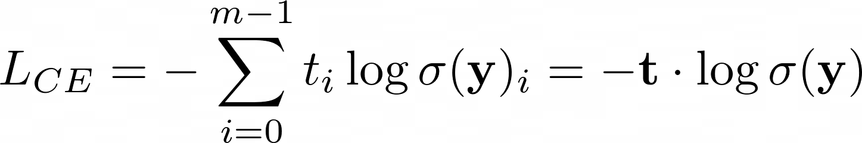
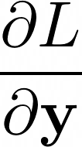
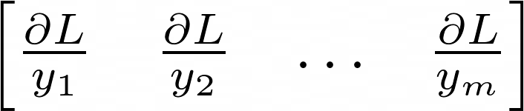

Training
Gradient descent
How to compute gradient?

Slide 78
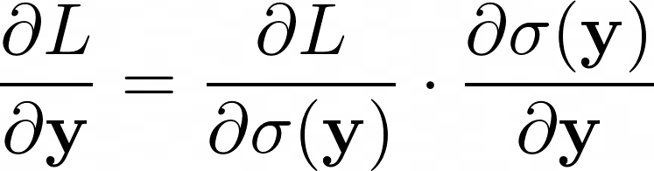
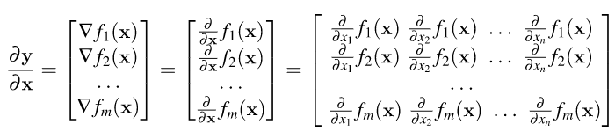

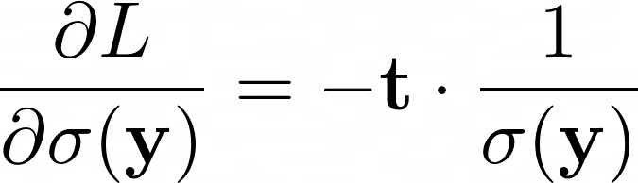
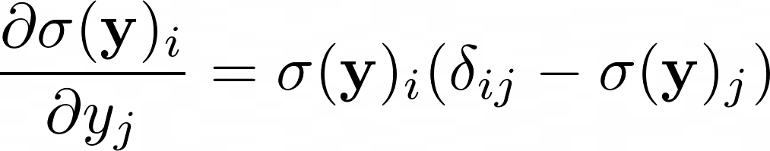

Training
Chain rule
Jacobian matrix
https://eli.thegreenplace.net/2016/the-softmax-function-and-its-derivative/

Slide 79
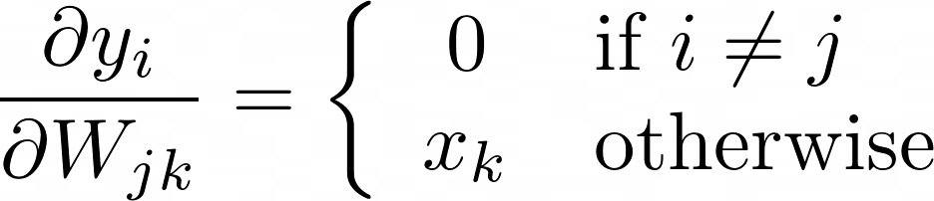
Training
Gradient descent
Learning rate

Slide 80

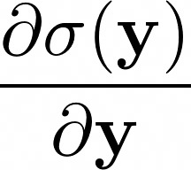
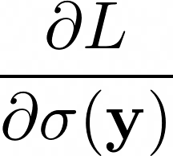
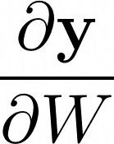
Back-propagation

Slide 81
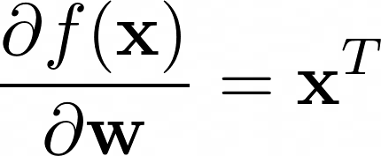
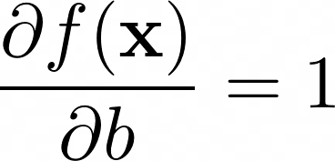

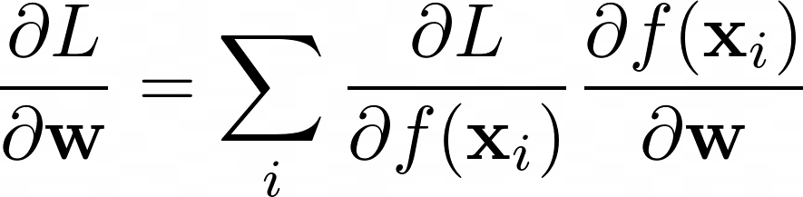
Back-propagation
224
224
3
Conv filter
Bias
Simplified convolution computation

Slide 82
Training: back-propagate errors
Gradient
…
Input image
Output
vector
GT
vector
Fully connected layer
Convolutional
layer
ReLU
layer
Pooling
layer

Slide 83
Back-propagation
For each layer in the network, compute local gradients (partial derivative)
Fully connected layers
Convolution layers
Activation functions
Pooling functions
Etc.
Use chain rule to combine local gradients for training

Slide 84
Classification Loss Functions
Cross entropy loss
Binary ground truth label
Logit
Notes:
When t and y have the same sign (meaning y predicts the right class) and |�|≥1, the hinge loss ℓ(�)=0. When they have opposite signs, ℓ(�) increases linearly with y, and similarly if |�|<1, even if it has the same sign (correct prediction, but not by enough margin).
In terms of accuracy, the “No Free Lunch Theorem” asserts that we can’t say that one is better than the other in all possible settings. Generally speaking, however, since the logistic loss function considers all the data points, it could be more prone to outliers leading to lower accuracy than the hinge loss. This doesn’t happen to hinge loss because, as mentioned above, it ignores most samples and considers only the points nearest to the separating hyperplane.
The hinge loss isn’t differentiable everywhere but is convex and simple to compute and optimize. The logistic loss is differentiable everywhere but doesn’t necessarily produce the widest margin between the opposing classes in binary classification.
the hinge loss takes into account only the training samples around the boundary and maximizes the boundary’s distance from them. In contrast, the logistic loss might not produce maximum margins. The reason is that all the samples affect it.

Slide 85

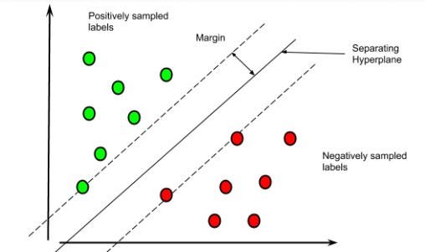



Classification Loss Functions
Cross entropy loss
Hinge loss for binary classification
Binary ground truth label
Logit
Max margin classification
Predict positive
ground truth label
Classification score
Predict negative
Notes:
When t and y have the same sign (meaning y predicts the right class) and |�|≥1, the hinge loss ℓ(�)=0. When they have opposite signs, ℓ(�) increases linearly with y, and similarly if |�|<1, even if it has the same sign (correct prediction, but not by enough margin).
In terms of accuracy, the “No Free Lunch Theorem” asserts that we can’t say that one is better than the other in all possible settings. Generally speaking, however, since the logistic loss function considers all the data points, it could be more prone to outliers leading to lower accuracy than the hinge loss. This doesn’t happen to hinge loss because, as mentioned above, it ignores most samples and considers only the points nearest to the separating hyperplane.
The hinge loss isn’t differentiable everywhere but is convex and simple to compute and optimize. The logistic loss is differentiable everywhere but doesn’t necessarily produce the widest margin between the opposing classes in binary classification.
the hinge loss takes into account only the training samples around the boundary and maximizes the boundary’s distance from them. In contrast, the logistic loss might not produce maximum margins. The reason is that all the samples affect it.

Slide 86

Classification Loss Functions
Hinge loss for multi-class classification
margin
Score corresponds to the most wrong label
Score corresponds to the ground truth label
https://torchmetrics.readthedocs.io/en/stable/classification/hinge_loss.html

Slide 87




Regression Loss Functions
Mean Absolute Loss or L1 loss
Mean Square Loss or L2 loss

Slide 88

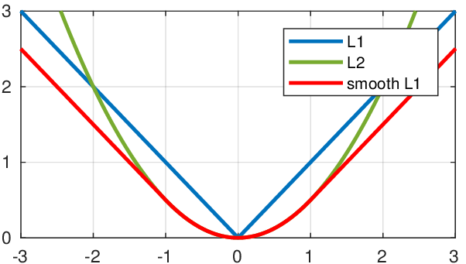

Regression Loss Functions
Smooth L1 loss
https://pytorch.org/docs/stable/generated/torch.nn.SmoothL1Loss.html
Notes:
Smooth L1-loss combines the advantages of L1-loss (steady gradients for large values of 𝑥�) and L2-loss (less oscillations during updates when 𝑥� is small).

Slide 89



Regression Loss Functions
Huber loss
Generalization of smooth L1 loss ( )
Notes:
Another form of smooth L1-loss is Huber loss. They achieve the same thing.
In statistics, the Huber loss is a loss function used in robust regression, that is less sensitive to outliers in data than the squared error loss.

Slide 90
Optimization
Gradient descent
Gradient direction: steepest direction to increase the objective
Can only find local minimum
Widely used for neural network training (works in practice)
Compute gradient with a mini-batch (Stochastic Gradient Descent, SGD)
Learning rate

Slide 91

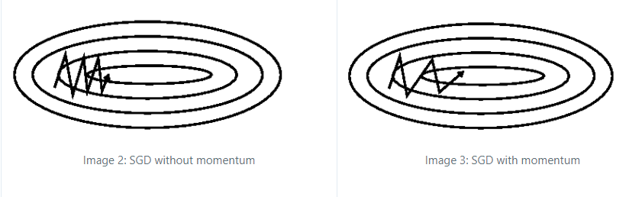
Optimization
Gradient descent with momentum
Add a fraction of the update vector from previous time step (momentum)
Accelerated SGD, reduced oscillation
momentum
Learning rate
https://ruder.io/optimizing-gradient-descent/

Slide 92
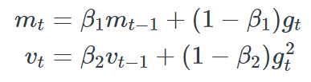


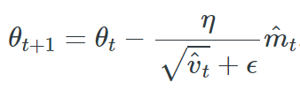
Optimization
Adam: Adaptive Moment Estimation
Exponentially decaying average of gradients and squared gradients
Bias-corrected 1st and 2nd moment estimates
Updating rule
Start m and v from 0s
Learning rate
Adaptive learning rate
Notes:
If the gradients are consistently large, the values of v_i will increase, and the learning rate will decrease. This adaptively adjusts the learning rate for each parameter and enables the usage of larger learning rates.
x to the y
beta to the power t

Slide 93
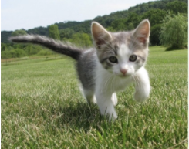
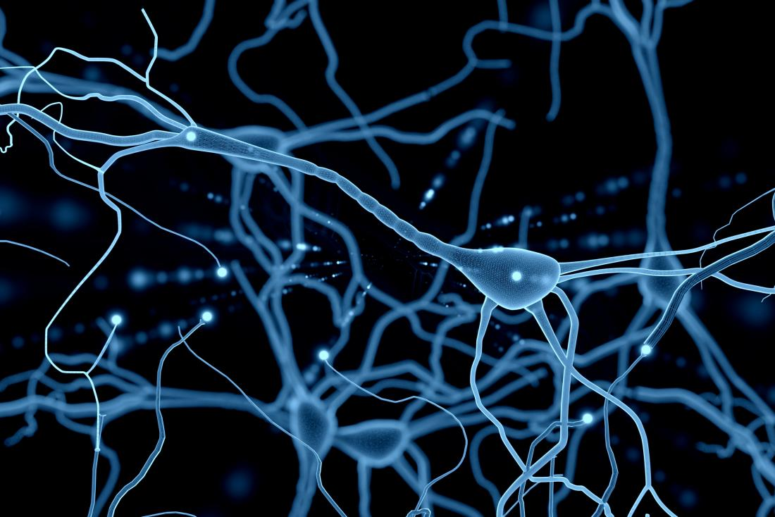



Computational Multisensory Perception
Learn functions (e.g., neural networks) to model and understand auditory and visual inputs
Visual
event label, sounding object location, …
$y$
Audio
$$f(v,a;θ)$$
Notes:
In Computational Multisensory Perception systems, we will learn functions to model and understand auditory and visual inputs. For example, we can use neural networks to learn nonlinear functions f to predict event label or sounding object location from visual and audio inputs using large-scale data.

Slide 94



Image + Audio
Image Feature Extractor Network
Feature Fusion
Audio Feature Extractor Network

Slide 95

Sound of Pixels
Sound of Pixels. Zhao et al., ECCV, 2018.

Slide 96
Single Images
Convolutional neural networks
High-level information
Depth
Object classes
Object poses
Etc.
CNN
Image

Slide 97



Sequential Data
Data depends on time
Video
Sentence
t-1
t
t+1
UT Dallas is a rising public research university in the heart of DFW.
t

Slide 98

Sequential Data Labeling
Video frame labeling
https://bleedai.com/human-activity-recognition-using-tensorflow-cnn-lstm/

Slide 99


Sequential Data Labeling
Part-of-speech tagging (grammatical tagging)
t

Slide 100






Sequential Data Labeling
Output label
Classifier
How to capture information across time?
Input

Slide 101

Recurrent Neural Networks
Output label
Internal state (memory)
RNN
RNN
RNN
Input
Notes:
Key idea: RNNs have an “internal state” that is updated as a sequence is processed

Slide 102



Hidden State Update
Updating function with parameters W
RNN
Hidden state at time t
Hidden state at time t-1
Input at time t

Slide 103

Using the Hidden State
RNN

Slide 104



Recurrent Neural Networks
Output label
Internal state (memory)
Input

Slide 105





Vanilla RNN
Hidden state updating rule
RNN
tanh tanh(x)

Slide 106












RNN Computation Graph
…
The same set of weights for different time steps

Slide 107
RNN Training
Loss
…
L1
L2
L3
…
Gradients

Slide 108

Backpropagation through Time
Output label
Hidden state
Input
What is the problem in this training paradigm?
Notes:
Forward through entire sequence to compute loss, then backward through entire sequence to compute gradient
Present a sequence of timesteps of input and output pairs to the network.
Unroll the network then calculate and accumulate errors across each timestep.
Roll-up the network and update weights.
Repeat. BPTT can be computationally expensive as the number of timesteps increases. If input sequences are comprised of thousands of timesteps, then this will be the number of derivatives required for a single update weight update.

Slide 109
Transformer
No recurrence
Attention only
Global dependencies between input and output
More parallelization compared to RNNs

Slide 110












Transformer: Encoder-Decoder with Attention
…
Encoder
How to compute the weights?
…
…
Decoder
[START]

Slide 111
Transformer: Attention
Input
(key, value) pairs (think about python dictionary)
A query
Output
Compare the query to all the keys to compute weights
Weighted sum of the values
Attention is all you need. Vaswani et al., NeurIPS’17

Slide 112




Transformer: Attention
Scaled Dot-Product Attention
Keys
Values
n queries
weights
Attention is all you need. Vaswani et al., NeurIPS’17
Notes:
particular attention "Scaled Dot-Product Attention”.
The input consists of queries and keys of dimension dk, and values of dimension dv. We compute the dot products of the query with all keys, divide each by √ dk, and apply a softmax function to obtain the weights on the values.
In practice, we compute the attention function on a set of queries simultaneously, packed together into a matrix Q. The keys and values are also packed together into matrices K and V .
for large values of dk, the dot products grow large in magnitude, pushing the softmax function into regions where it has extremely small gradients. To counteract this effect, we scale the dot products by √ 1 dk .

Slide 113







Transformer: Attention
Multi-Head Attention
Suppose the latent vector is with dimension
Projection
Attention is all you need. Vaswani et al., NeurIPS’17
Notes:
Instead of performing a single attention function with dmodel-dimensional keys, values and queries, we found it beneficial to linearly project the queries, keys and values h times with different, learned linear projections to dk, dk and dv dimensions, respectively. On each of these projected versions of queries, keys and values we then perform the attention function in parallel, yielding dv-dimensional output values. These are concatenated and once again projected, resulting in the final values,
Multi-head attention allows the model to jointly attend to information from different representation subspaces at different positions. With a single attention head, averaging inhibits this.

Slide 114


Transformer: Encoder
Encoder output
Self-attention
Keys, values and queries are all the same
n input tokens
Residual connection
Layer normalization
N = 6
$$a^{l}≔ γ{\hat{a}}^{l}+β ={LN}_{γ,β}(a^{l})$$
$${\hat{a}}^{l}=\frac{a^{l}−μ^{l}}{σ^{l}}$$
Attention is all you need. Vaswani et al., NeurIPS’17
Notes:
In the encoder of transformer, we use an attention mechanism what we called self-attention. In a self-attention layer all of the keys, values and queries come from the same place, in this case, the output of the previous layer in the encoder. Each position in the encoder can attend to all positions in the previous layer of the encoder.
Layer normalization is used in transformer models to ensure that the input and output of each layer have the same mean and variance, which helps to speed up training and improve model performance. Layer normalization also helps to reduce the risk of overfitting by reducing the dependence of the model on any single data point. We compute the layer normalization statistics over all the hidden units in the same layer, where H denotes the number of hidden units in a layer. Under layer normalization, all the hidden units in a layer share the same normalization terms � and �, but different training cases have different normalization terms.
γ� and β� are learnable parameters

Slide 115
Transformer: Encoder
Feed Forward Network
Positional encoding
Make use the order of the sequence
With dimension for each input
Attention is all you need. Vaswani et al., NeurIPS’17
Notes:
In addition to attention sub-layers, each of the layers in our encoder and decoder contains a fully connected feed-forward network, which is applied to each position separately and identically. This consists of two linear transformations with a ReLU activation in between.
Since our model contains no recurrence and no convolution, in order for the model to make use of the order of the sequence, we must inject some information about the relative or absolute position of the tokens in the sequence. To this end, we add "positional encodings" to the input embeddings at the bottoms of the encoder and decoder stacks. The positional encodings have the same dimension dmodel as the embeddings, so that the two can be summed. There are many choices of positional encodings, learned and fixed.
In this work, we use sine and cosine functions of different frequencies. pos is the position and i is the dimension. That is, each dimension of the positional encoding corresponds to a sinusoid. The wavelengths form a geometric progression from 2π to 10000 · 2π. We chose this function because we hypothesized it would allow the model to easily learn to attend by relative positions, since for any fixed offset k, P Epos+k can be represented as a linear function of P Epos. We chose the sinusoidal version because it may allow the model to extrapolate to sequence lengths longer than the ones encountered during training.

Slide 116



Transformer: Decoder
Output embedding
Encoder output
[START]
…
…
Mask out current and future outputs during training (setting to )
Shifted right by one position and insert the start token
Attention is all you need. Vaswani et al., NeurIPS’17

Slide 117
Transformer: Decoder
Encoder-decoder attention
(Key, value): encoder output
Queries: decoder output
Every position in the decoder attends to all positions in the input sequence
Softmax
Predicts next-token probabilities
Encoder output
Self-attention
Attention is all you need. Vaswani et al., NeurIPS’17

Slide 118
Transformer
Attention is all you need. Vaswani et al., NeurIPS’17

Slide 119
Further Reading
Stanford CS231n, lecture 5, Convolutional Neural Networks http://cs231n.stanford.edu/schedule.html
Deep learning with PyTorch https://pytorch.org/tutorials/beginner/deep_learning_60min_blitz.html
AlexNet (2012): https://papers.nips.cc/paper/2012/hash/c399862d3b9d6b76c8436e924a68c45b-Abstract.html
Vgg16 (2014): https://arxiv.org/abs/1409.1556
GoogleNet (2014): https://arxiv.org/abs/1409.4842
ResNet (2015): https://arxiv.org/abs/1512.03385

Slide 120
Further Reading
Stanford CS231n, lecture 3 and lecture 4, http://cs231n.stanford.edu/schedule.html
Deep learning with PyTorch https://pytorch.org/tutorials/beginner/deep_learning_60min_blitz.html
Dropout: A Simple Way to Prevent Neural Networks from Overfitting https://jmlr.org/papers/v15/srivastava14a.html
Matrix Calculus: https://explained.ai/matrix-calculus/

Slide 121
Further Reading
Sound of Pixels, 2018 http://sound-of-pixels.csail.mit.edu/
Audio-Visual Event Localization in Unconstrained Videos, 2018 https://openaccess.thecvf.com/content_ECCV_2018/papers/Yapeng_Tian_Audio-Visual_Event_Localization_ECCV_2018_paper.pdf
Unified Multisensory Perception: Weakly-Supervised Audio-Visual Video Parsing, 2020 https://arxiv.org/pdf/2007.10558.pdf
Visual to Sound: Generating Natural Sound for Videos in the Wild, 2018 https://arxiv.org/abs/1712.01393
MakeItTalk: Speaker-Aware Talking-Head Animation, 2020. https://arxiv.org/abs/2004.12992
Learning in Audio-visual Context: A Review, Analysis, and New Perspective, 2022. https://arxiv.org/abs/2208.09579

Slide 122
Further Reading
Deep Learning Textbook: Sequence Modeling: Recurrent and Recursive Nets https://www.deeplearningbook.org/contents/rnn.html
Stanford CS231n, lecture 10, Recurrent Neural Networks http://cs231n.stanford.edu/
Long Short Term Memory https://www.researchgate.net/publication/13853244_Long_Short-term_Memory
https://colah.github.io/posts/2015-08-Understanding-LSTMs/
Gated Recurrent Units https://arxiv.org/pdf/1412.3555.pdf

Slide 123
Further Reading
Learning Phrase Representations using RNN Encoder-Decoder for Statistical Machine Translation https://arxiv.org/abs/1406.1078
Neural Machine Translation by Jointly Learning to Align and Translate https://arxiv.org/abs/1409.0473
Transformer: Attention is all you need https://arxiv.org/abs/1706.03762
Vision transformer: An Image is Worth 16x16 Words: Transformers for Image Recognition at Scale https://arxiv.org/abs/2010.11929

